Slide 1
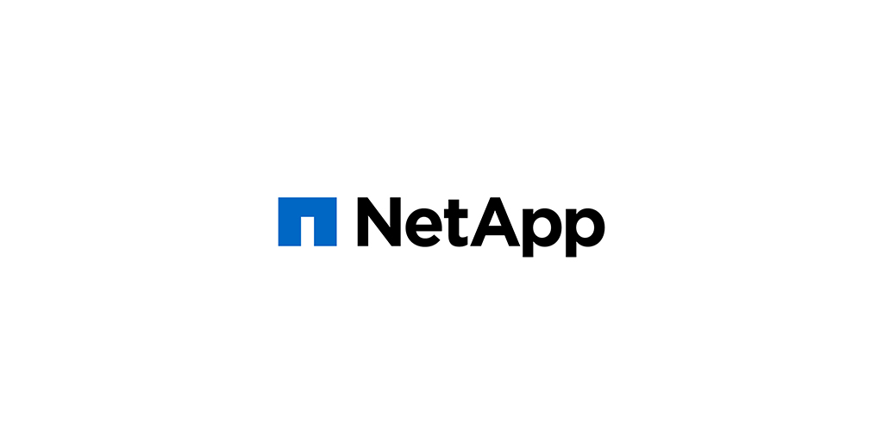
Solution Highlight: Cloud Sync: Data Broker

Slide 2
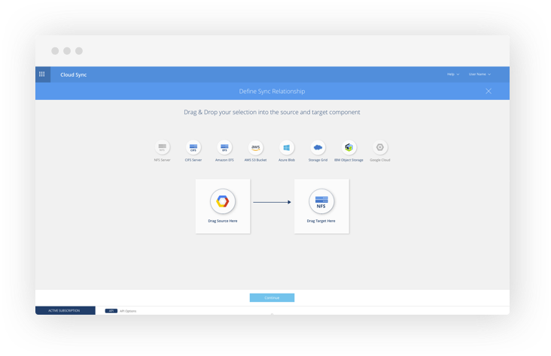
What is NetApp Cloud Sync?
Cloud Sync is NetApp’s service for rapid and secure data synchronization. Whether you need to transfer files between on-premises NFS or CIFS file shares, Amazon S3 object format, Azure Blob, IBM Cloud Object Storage or NetApp StorageGRID® Webscale appliance, Cloud Sync moves the files where you need them quickly and securely.

Slide 3

Primary Use Cases
NetApp has stated that the main use case they see for Cloud Sync is a one-time on-prem to cloud data migration.
Syncing data between multiple cloud providers
Big Data Analytics
Data protection
Hybrid cloud
Syncing data between regions (EastUS2 -> West Europe)
Data archiving - migrating data to cold tier storage

Slide 4
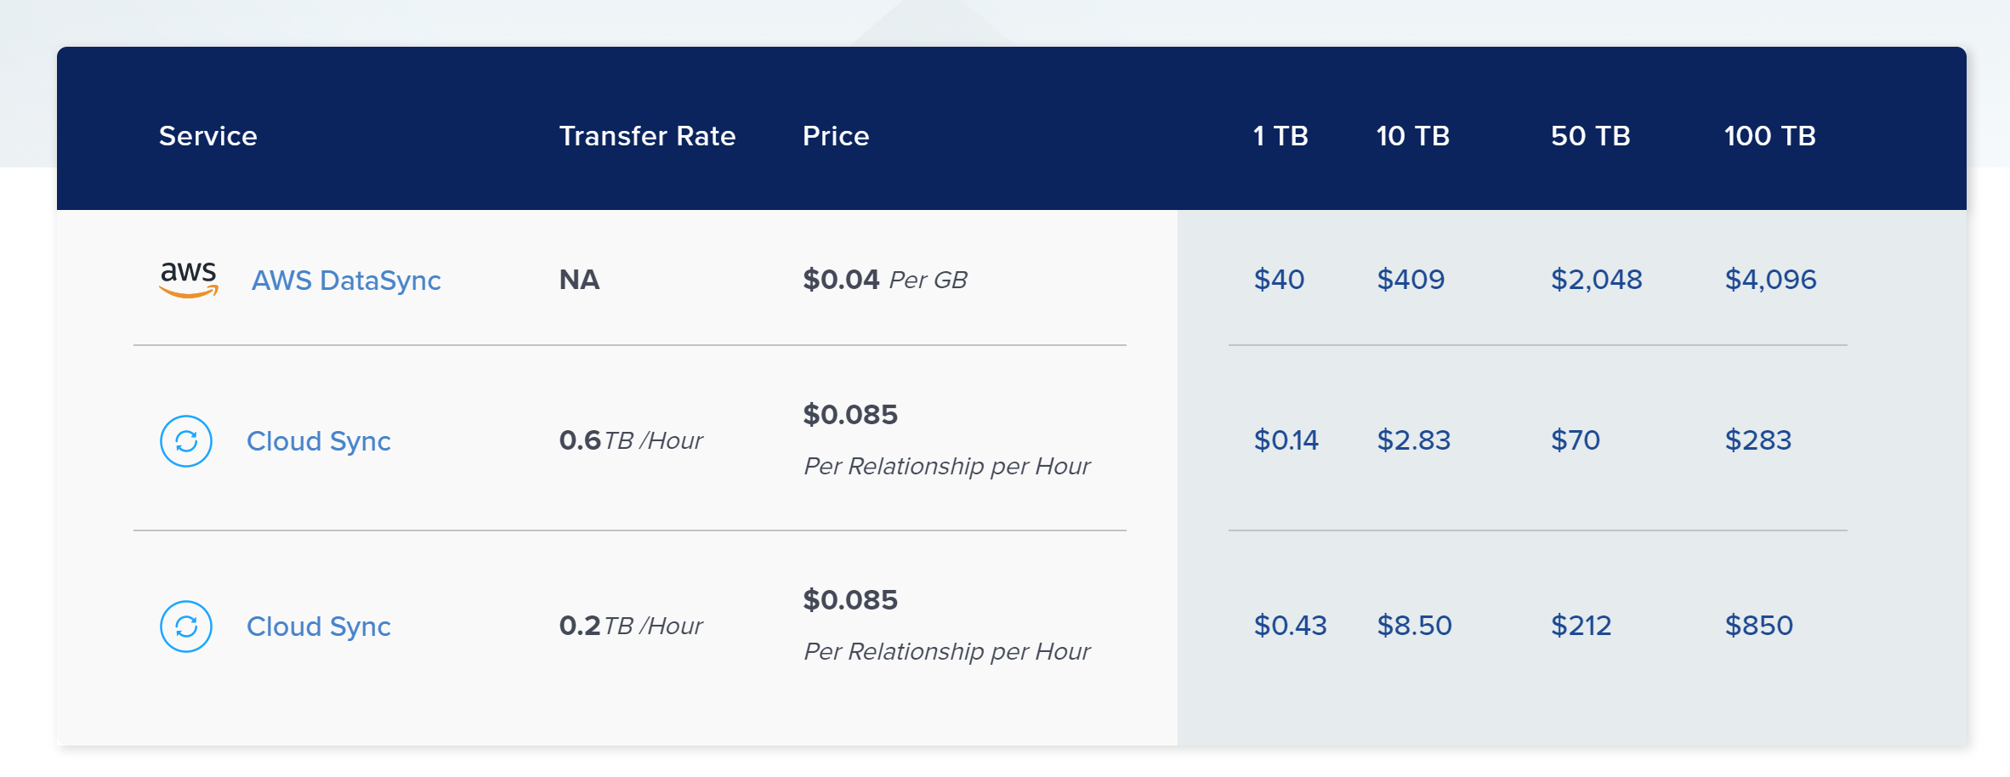
Pricing Structure
With Cloud Sync, you pay for the Sync Relationships on an hourly basis.
There is no per GB charge like many other offerings (AWS Data Sync for example).
This makes it more cost effective if you’re looking to move a HUGE amount of data over – since you’re just paying for the relationship to be active and running.
No charge if syncing to Azure NetApp Files account

Slide 5
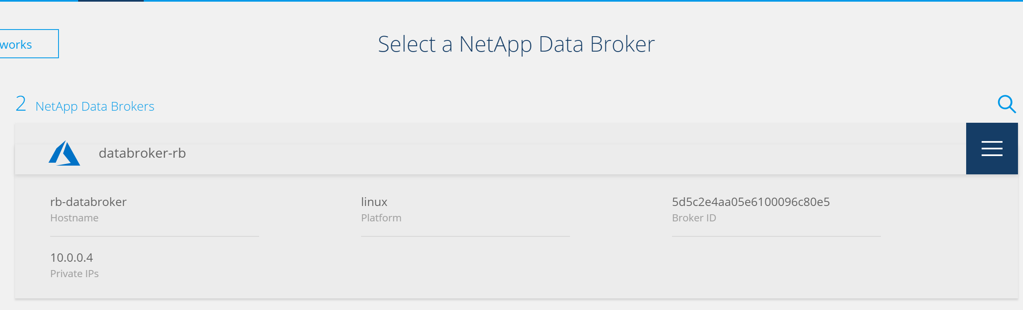
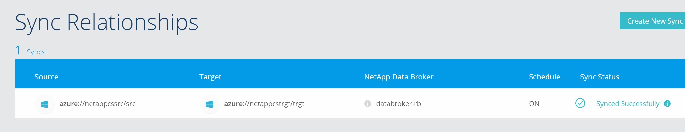
How does it work?
Cloud Sync relies on a data broker virtual machine to initiate/monitor the synchronization/scheduling of the synchronization. Depending on the source/target endpoints – the Data Broker plays different roles.
Blob to blob – the actual file transfer is handled by the Azure Storage Account – the Data Broker just schedules/monitors.
NFS to blob – the Data Broker is a mediator – actually moving the data
Once the Data Broker is created, you manage the synchronizations (Sync Relationships) via the NetApp Cloud website.
You can have multiple relationships per Data Broker – as long as the data broker can communicate with the source/target storage endpoints.

Slide 6
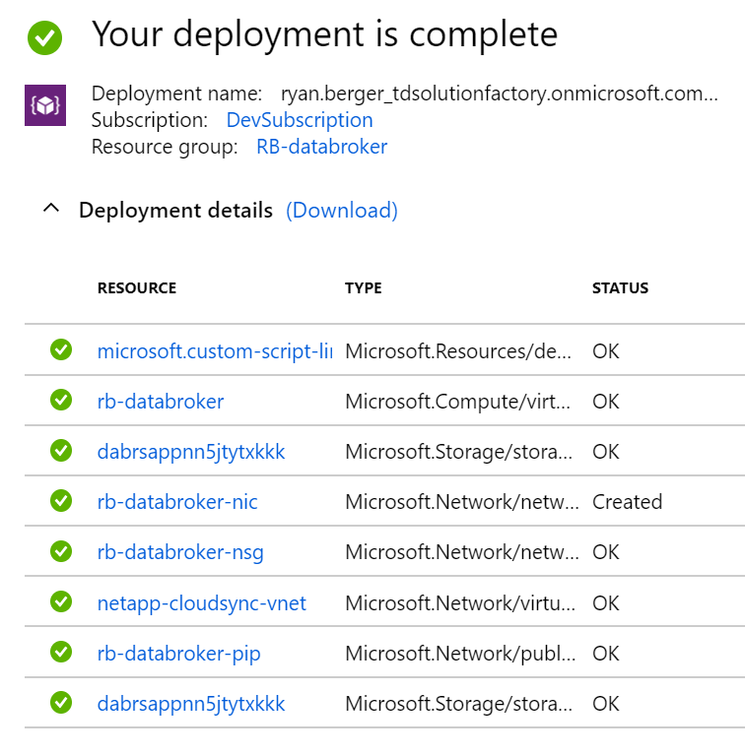
What are we automating?
We automate the creation of the Data Broker virtual machine and all dependent resources.
We give you the ability to build this onto a new virtual network, or put it onto an existing one at the time of deployment.
So you can deploy it onto a virtual network that you’ve already set up/has access to your storage
We leverage NetApp’s Cloud Sync API to request a new Data Broker ID and an installation script.
This allows the Data Broker from our automation to automatically check in to the NetApp Cloud Sync web UI for immediate use.

Slide 7
Demo
Demo deployment

